Slide 1
EXTREME ENVIRONMENT
THE DESERT REGION
GROUP 7

Slide 2
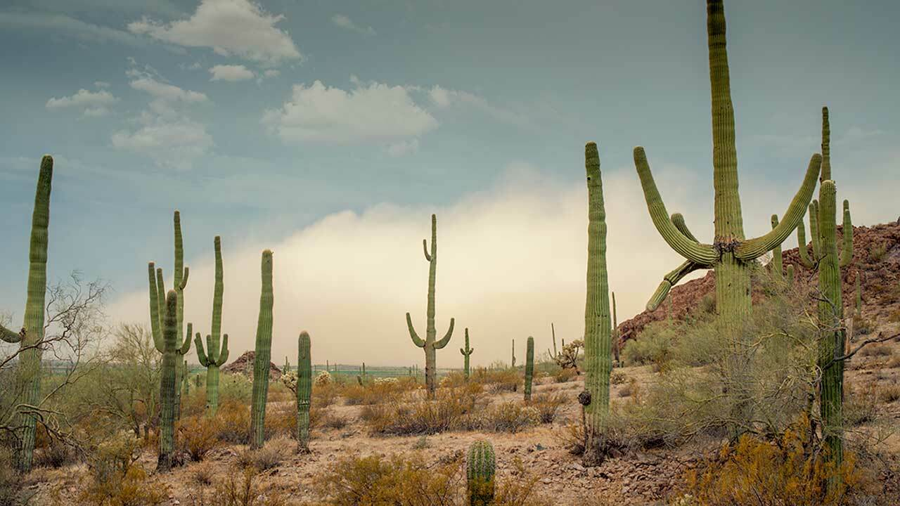
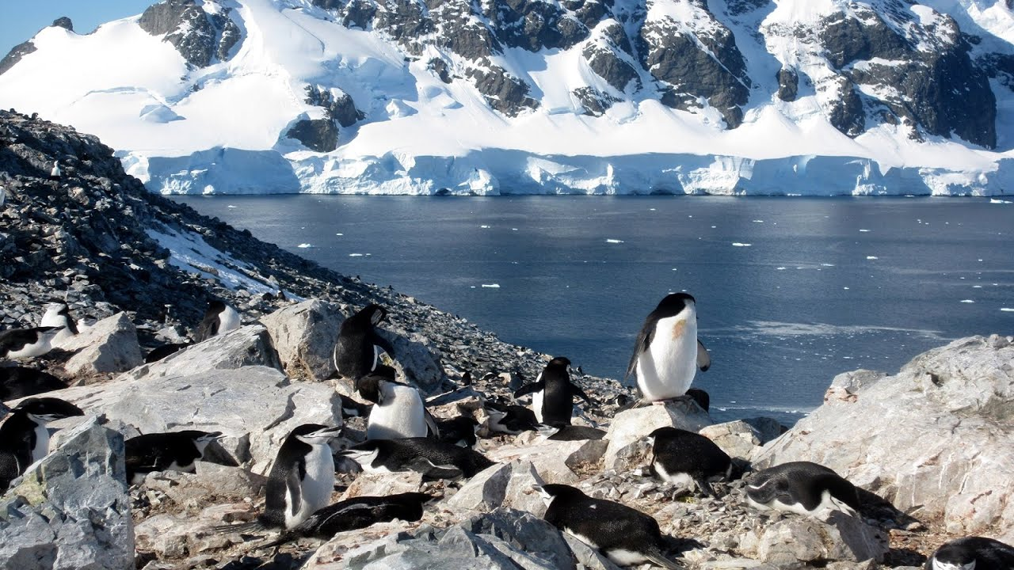
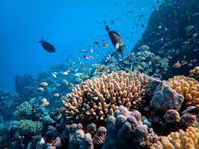
EXTREME ENVIRONMENTS.
Extreme environments are habitats characterized by harsh environmental conditions beyond the optimal range for the development of humans.
Examples are;
The Desert
The Deep Ocean
The Polar region

Slide 3
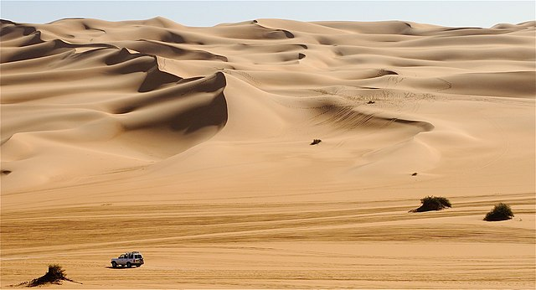
THE DESERT REGION
Deserts are areas of land that receives very little precipitation.
Deserts are mostly described as “hot”, “dry” and “empty”.
Temperature during daytime can be as high as 54⁰C but it can be cold in other deserts.
Deserts are able to support variety of life forms.

Slide 4
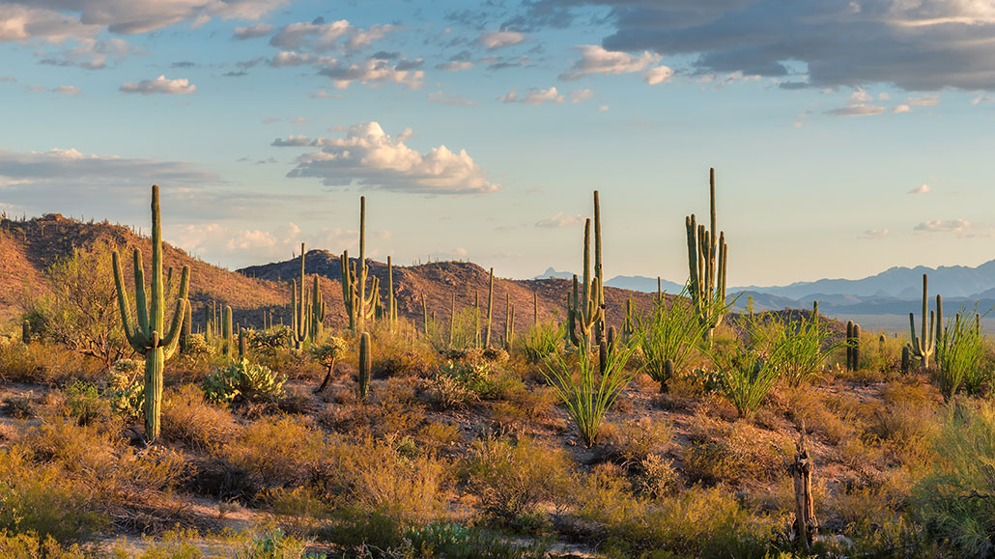
THE DESERT REGION
Precipitation in deserts is very low hence, very little water is available to plants and other organisms.
Deserts can be found on every continent and cover about one-fifth of earth’s land area.
Deserts can be mountainous, a sea of shifting sand, dunes or dry expanses of rock.

Slide 5
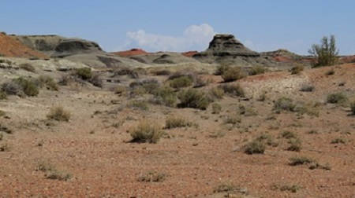
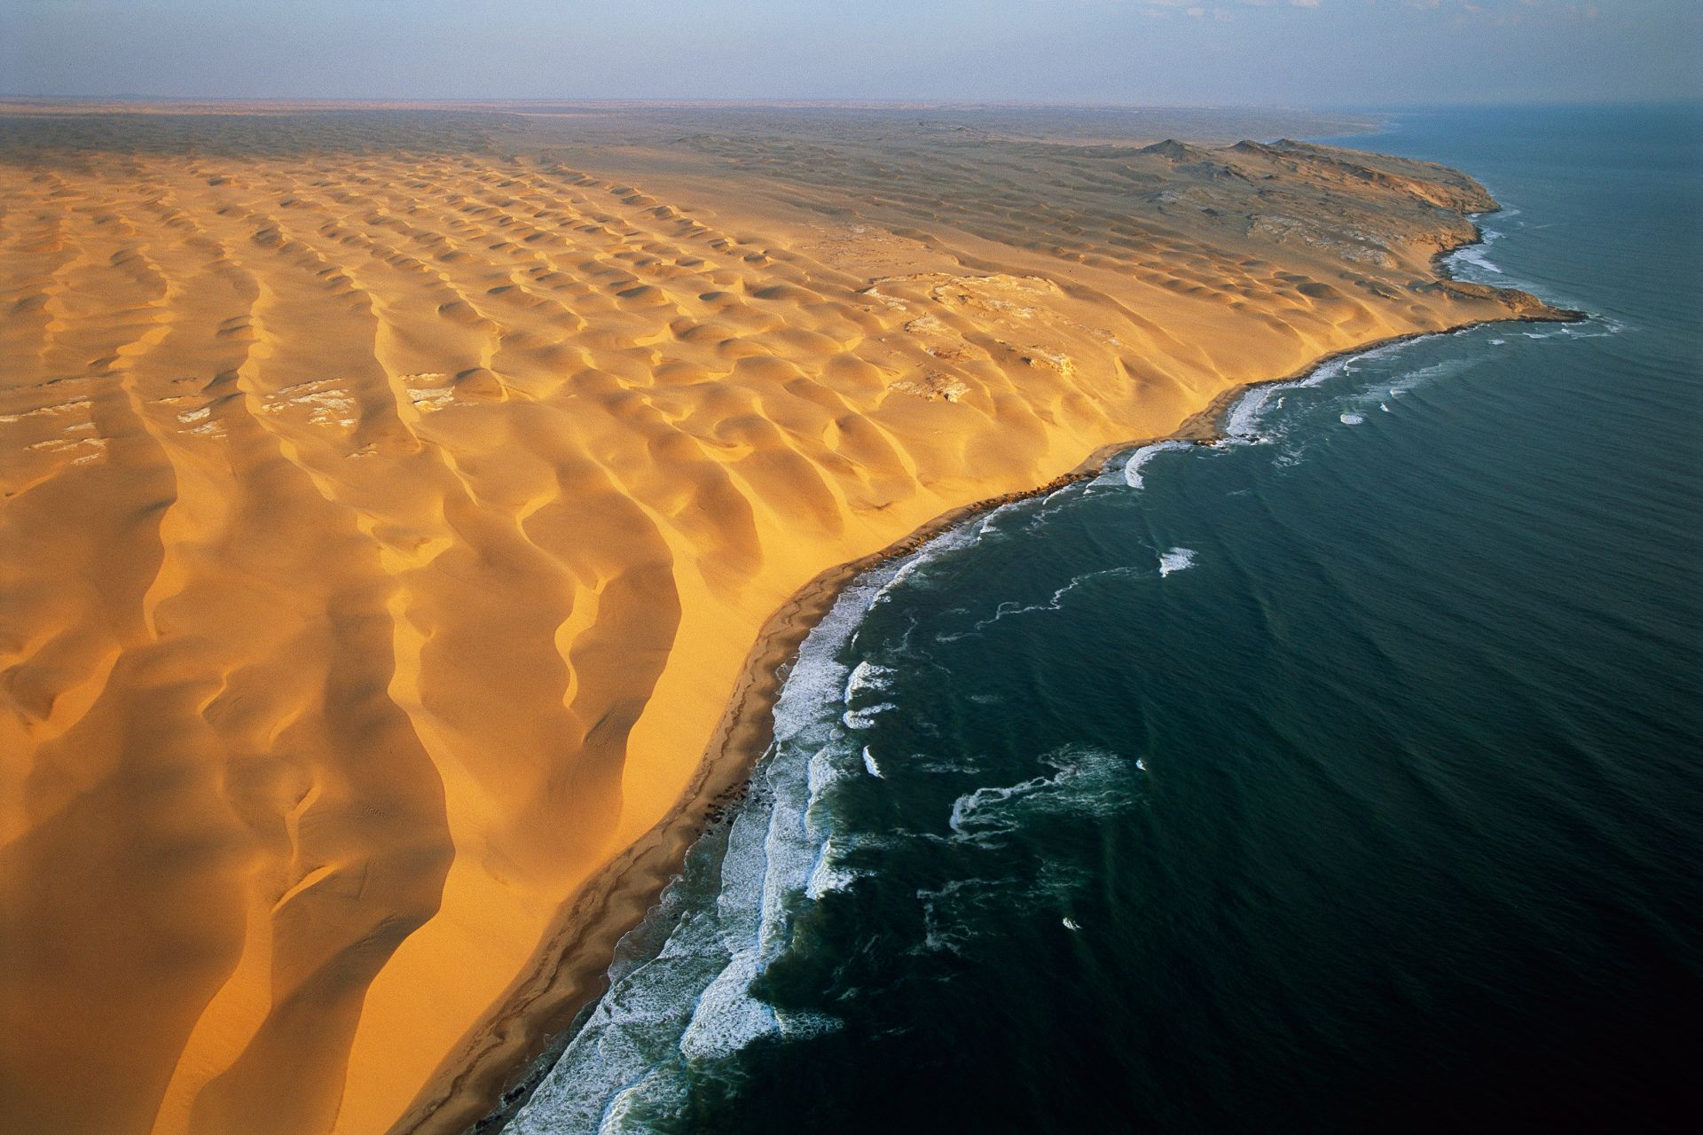
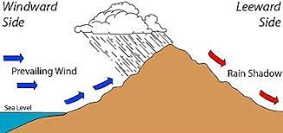
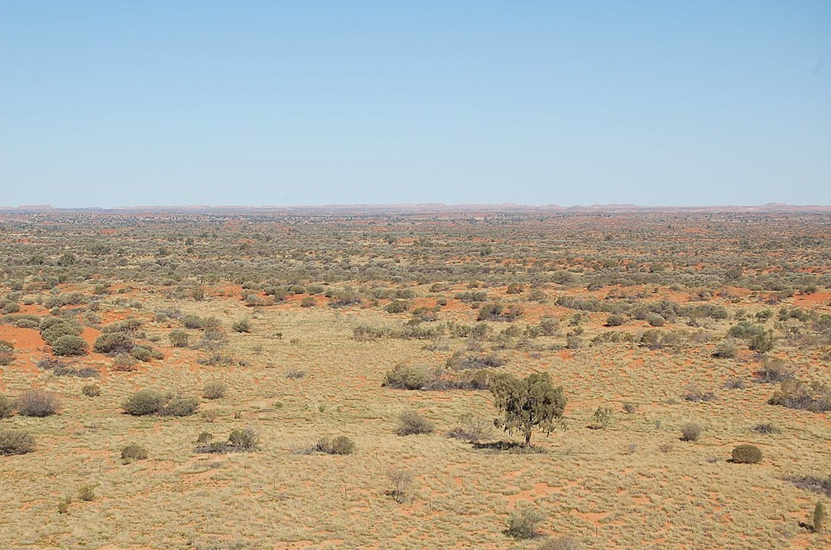
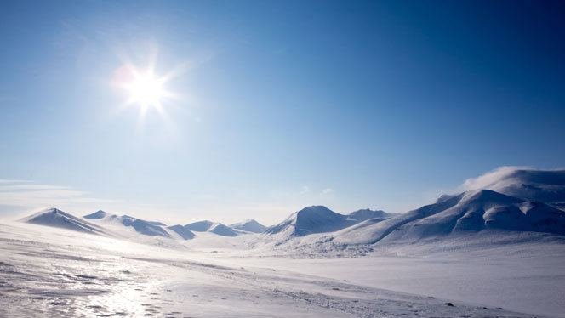
EXAMPLES OF DESERTS.
Subtropical Desert
The Coastal Desert
The Rain shadow Desert
The Interior Desert
The Polar Desert

Slide 6
THE SUBTROPICAL DESERTS.
They the hottest of desert types.
They are found along the Tropic of cancer or along the Tropic of Capricorn.
They deserts formed by the circulation patterns of air masses.
Examples are; Sahara Desert, the Kalahari Desert and the Tanami Desert.

Slide 7
THE COASTAL DESERTS.
They are formed from cold ocean currents.
Characterized by a layer of fog.
High humidity but atmospheric changes that normally cause rainfall are not present.
Example is the Atacama Desert in Chile.

Slide 8
RAIN SHADOW DESERTS.
These are deserts that exist near leeward slopes of some mountain ranges.
Example is Death Valley in U.S. states of California.

Slide 9
INTERIOR DESERTS.
These are deserts found in the hearts of continents.
They exist because no moisture-laden winds reach them.
Example is the Gobi desert in China and Mangolia

Slide 10
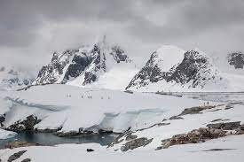
POLAR DESERTS.
They are deserts form in the artic and the Antarctic.
High amount of water but it is frozen in glaciers and ice cups.

Slide 11
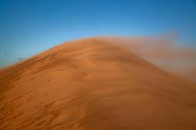
CHARACTERISTICS OF DESERTS.
Arid environment
High wind velocity
Absence of water vapour in the air
Sparsity of cloud cover
Low precipitation
Extreme temperatures
Mirage
Potential evaporation highest
Drought
Scarce vegetation and animals face shortage of food

Slide 12
ORGANISMS IN THE DESERT.
Plants adapted to the desert region are called xerophytes.
Animals adapted to the desert region are called xerocoles.
They include species of insects, reptiles, birds and mammals.
They can be homeotherms and poikilotherms.
Some xeroc oles avoid the sun by resting in scarce shade
Many escape the heat in cool burrows they dig in the ground.

Slide 13
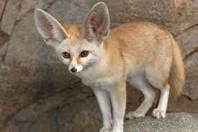
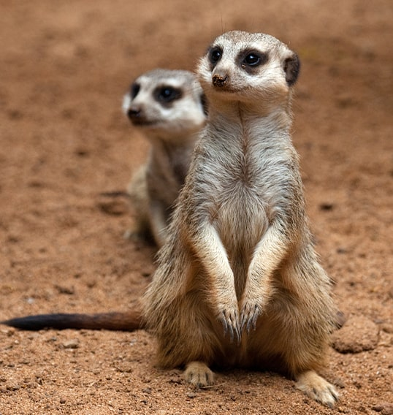
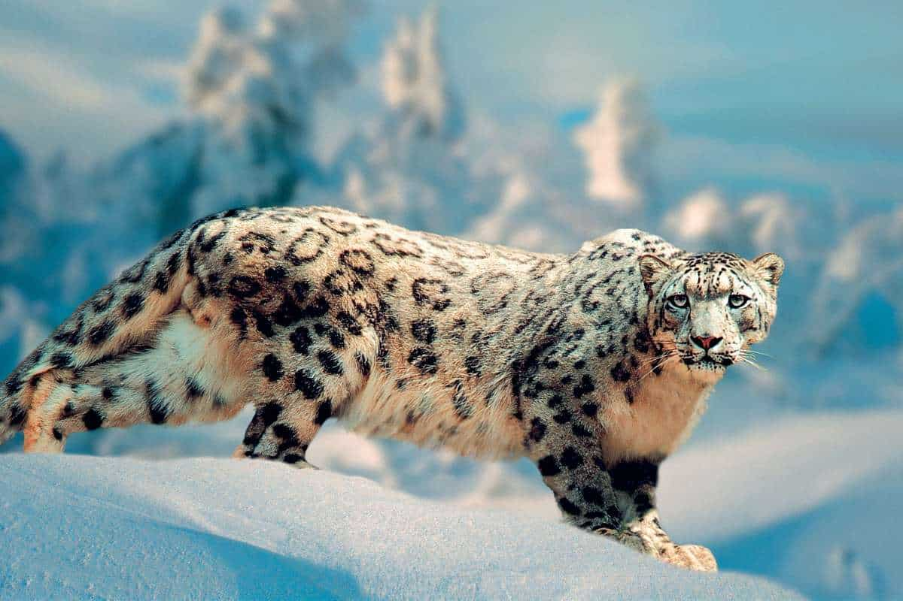
The Fennec Fox
The Meerkat
The Snow Leopard

Slide 14
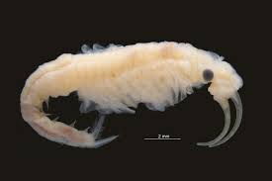
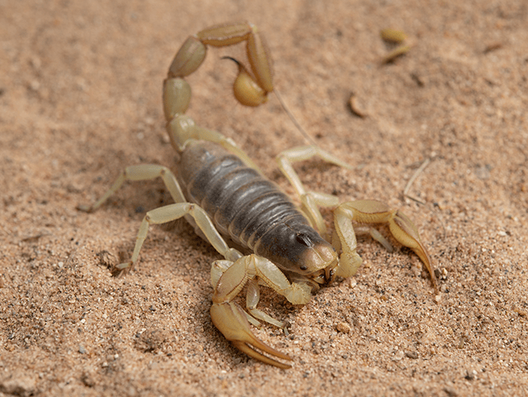
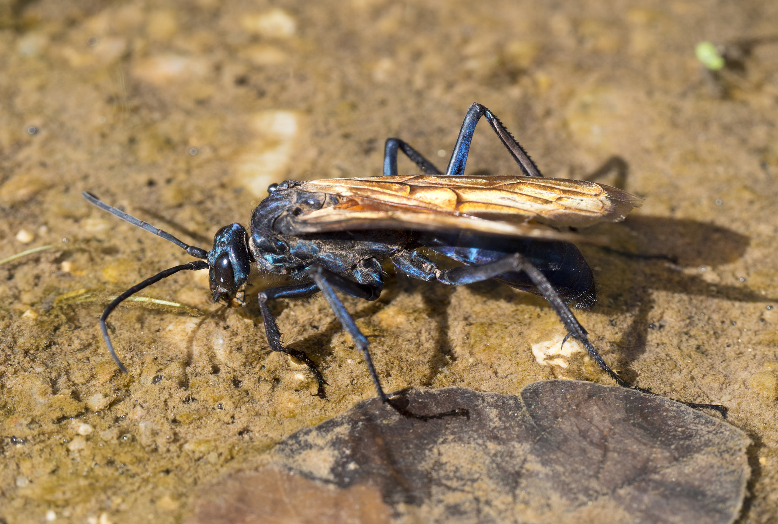
The Fairy Shrimp
The Giant Hairy Scorpion
The Tarantula Hawk

Slide 15
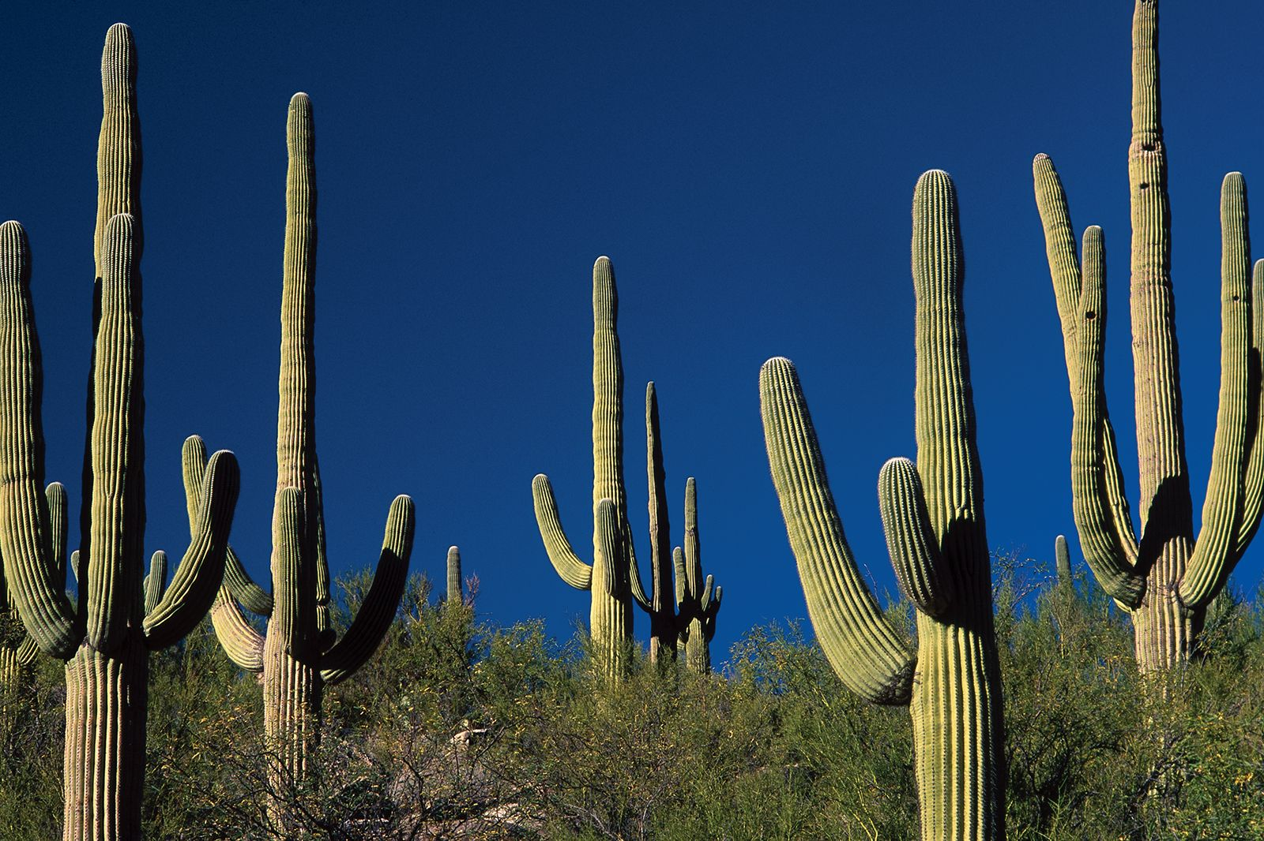
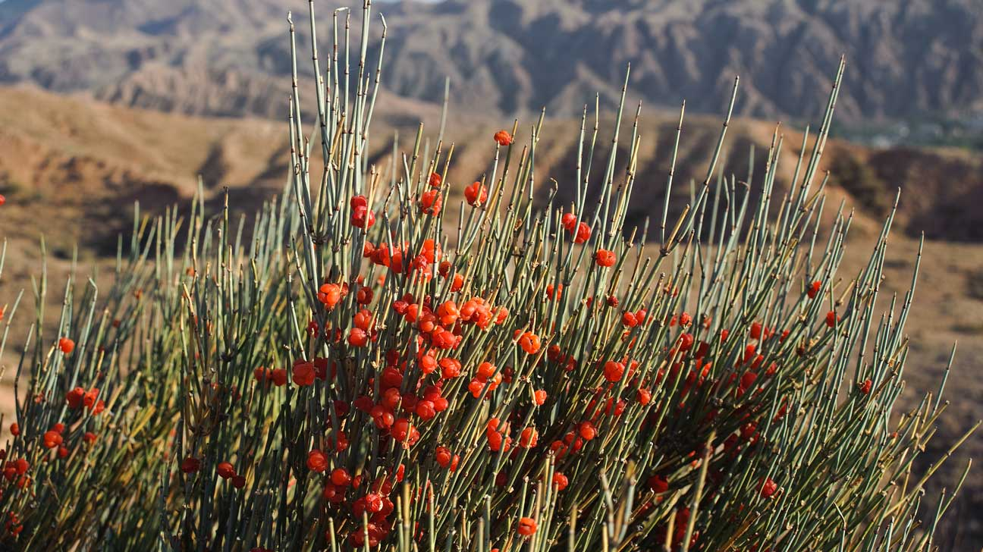
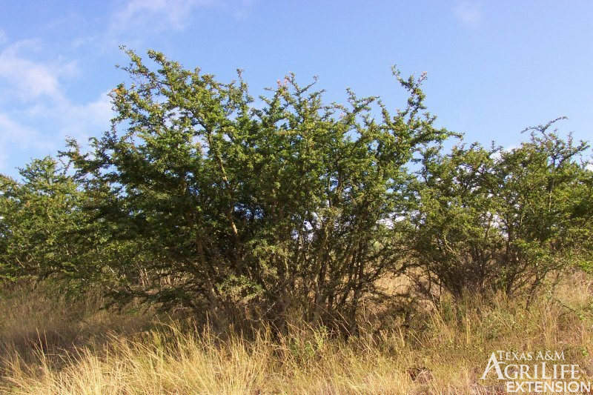
The Cactus
The Ephedra
The Blackbrush

Slide 16
CONCLUSION
Deserts are often described as hostile place to avoid, but with today’s improved technology and knowledge, people now value desert resources and biodiversity. Organizations are now working to preserve the desert biodiversity and increase desert productivity.

Slide 17
THANK YOU
.

